Slide 1
Project proposal presentation
~WELCOME~

Slide 2
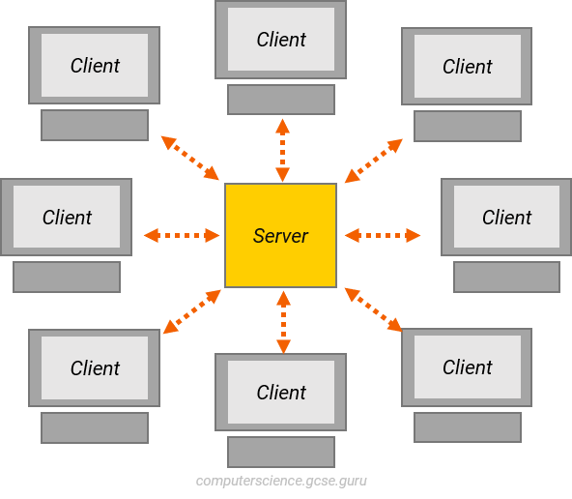
‘IIT HelpDesk’
It is a command line multi clients chatroom
software.
What will it do?
Enrich teachers-students collaboration in real
time through Online.

Slide 3
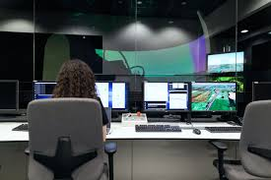
motivation
Offering a platform for real-time collaboration.
Quick information exchange.
Students’ opinions reach sirs quickly.
Provide any notice within a second.
OBJECTIVE
Lightweight and fast.
It will save our time.
Develop learning & supporting skills.
Faster communication.
Data Secure.

Slide 4
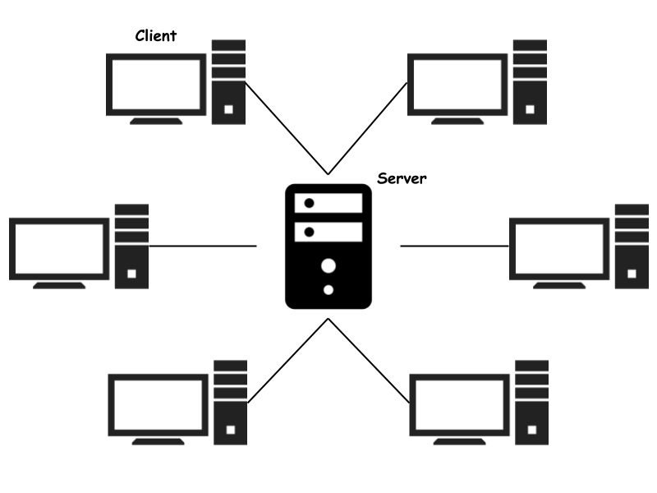
Log-in system
Multi client facilities
Message history
Encrypting messages
Features

Slide 5

Challenges
Manually creating a chatroom is a hectic process.
Build this project on time.
Ensure the quality of this project.
Securing and storing data.
Connect and run the network environment through cli.
Implementation

Slide 6


Knowledge:
Socket Programming
Encryption Algorithm
Language and IDEs:

Slide 7
PROPOSED TIMELINE
Name of task | April 2 | May | June | July | August
Proposal
Requirement gathering
Feasibility test
Designing
Implementation
Testing
Delivery

Slide 8
Deliverables
Source Code
Document
Jar File

Slide 9

Any Questions?

Slide 10
~Thank You~

